Slide 1

Swarm robot

Slide 2
HISTORY

Slide 3
HISTORY OF SWARM ROBOT
Swarm robotics has its origins in swarm intelligence and, in fact, could be defined as "embodied swarm intelligence". Initially, the main focus of swarm robotics research was to study and validate biological research (Beni, 2005). Early collaboration between roboticists and biologists helped bootstrap swarm robotics research, which has since become a research field in its own right. In recent years, the focus of swarm robotics has been shifting: from a bio-inspired field of robotics, swarm robotics is increasingly becoming an engineering field whose focus is on the development of tools and methods to solve real problems (Brambilla et al., 2013).

Slide 4
BASIC SYSTEM ARCHICTECTURE

Slide 5
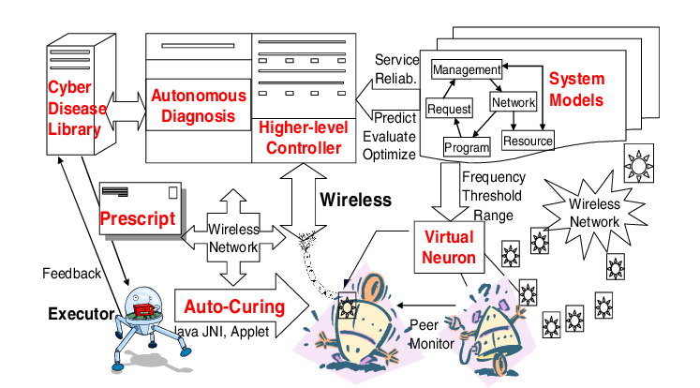
BASIC SYSTEM ARCHITECTURE

Slide 6
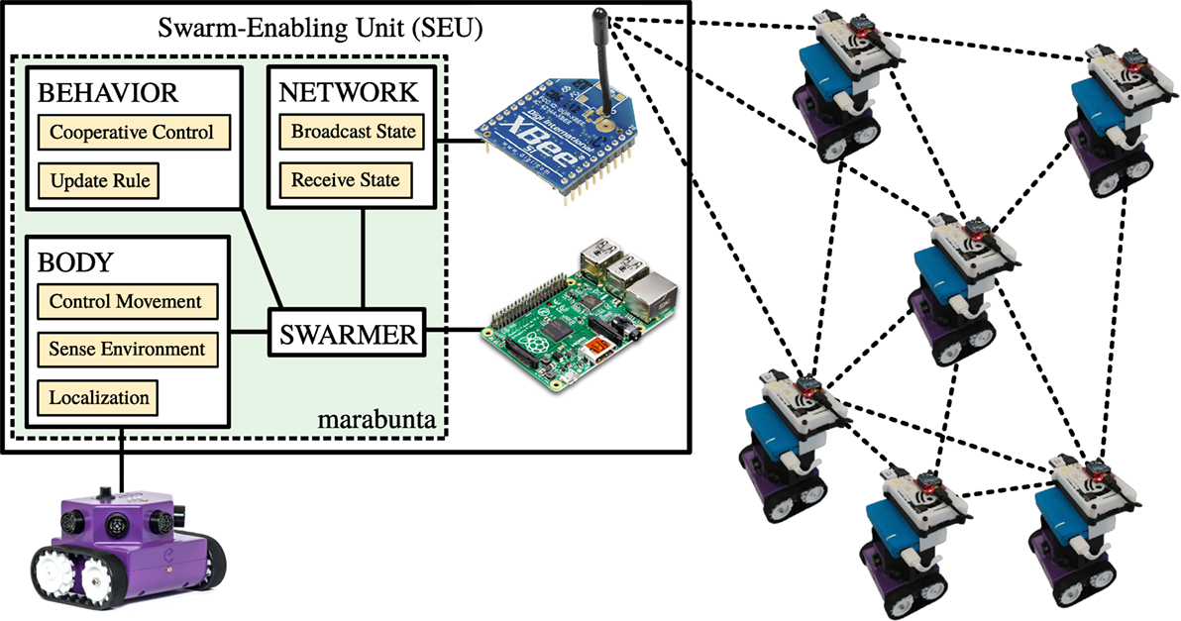
BASIC SYSTEM ARCHITECTURE

Slide 7
ROBOT DESIGN

Slide 8
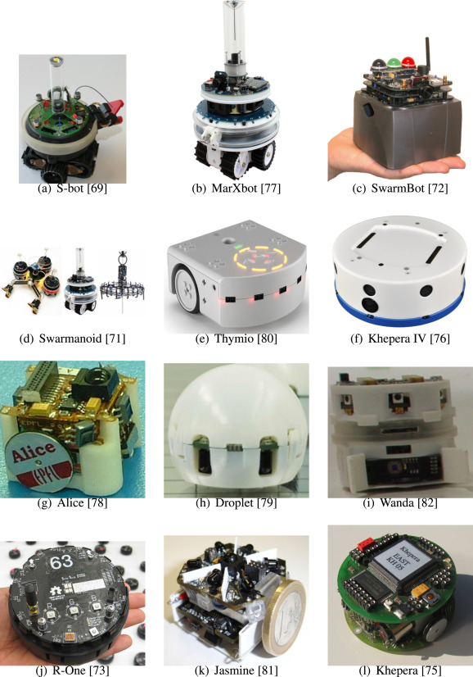
Variations of swarm robots

Slide 9
ACTUATORS AND LOCOMOTIONS

Slide 10
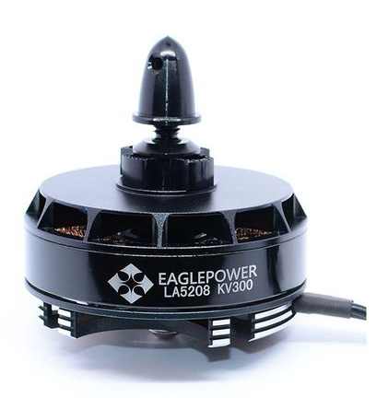
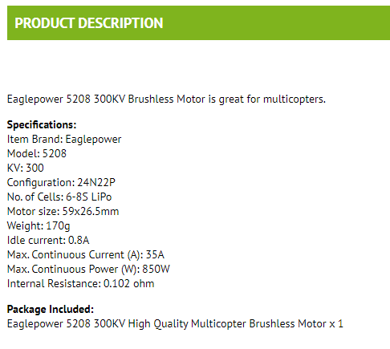
MOTORS

Slide 11
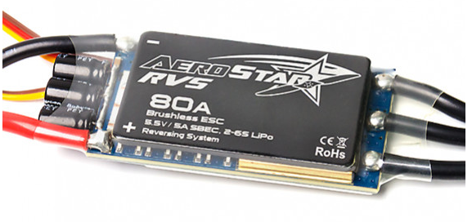
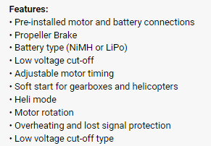
MOTOR CONTROLLER

Slide 12
NAVIGATION SYSTEM AND CONTROLLER

Slide 13
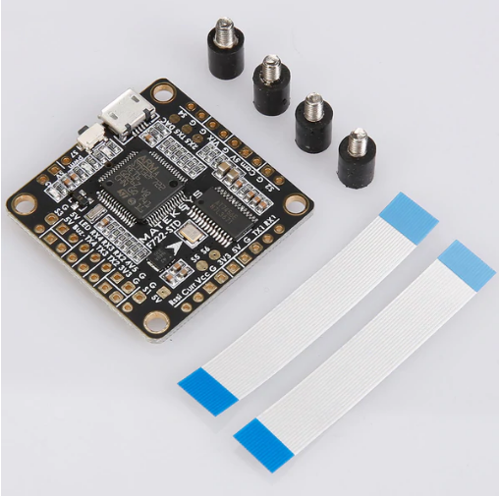

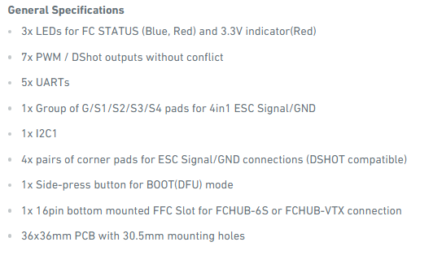

Slide 14
DATA COLLECTION

Slide 15
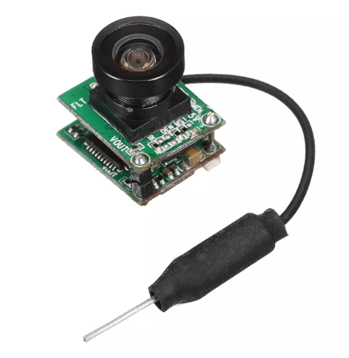
CAMERA
Mini 5.8GHz 48CH 25mW VTX With 700TVL 1/4 CMOS NTSC FPV Camera For RC Drone
Description: Item Name: VTX + FPV Camera Working Temperature: -10 ℃ ~ +60℃ Dimension: 153x122mm + 16.1x14.5mm Weight: 4g Specifications of Camera: Sensor: 1/4" CMOS Resolution: 700TVL Angle: H: 120° / V: 100° Format: NTSC 640X480 Power Consumption: 250±20mA, 5V DCN Working Voltage: 3.7V ~ 5.5V Specifications of VTX: Frequency: 5645 ~ 5945MHz Channel: 40 Working Voltage: 3.7V ~ 5.5V Output Power: 25mw Output Signal Strength: 13±1dBm Frequency Stability: ±100kHz (TYP) Frequency Accuracy:±200kHz (TYP) Channel Carrier Error: 1dB All Harmonics: -50dBm (Max) Antenna Port: 50ΩMini 5.8GHz 48CH 25mW VTX With 700TVL 1/4 CMOS NTSC FPV Camera For RC Drone

Slide 16
DATA TRANSMISSION

Slide 17
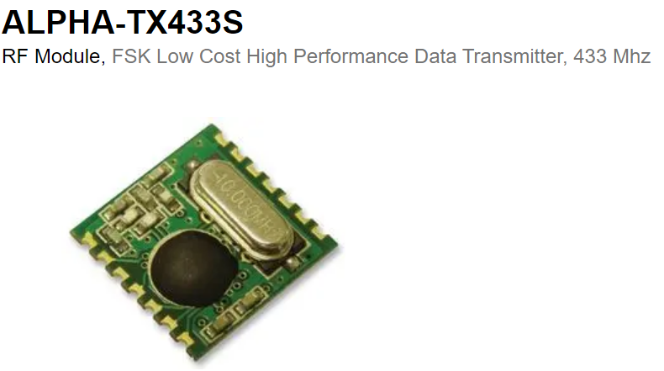
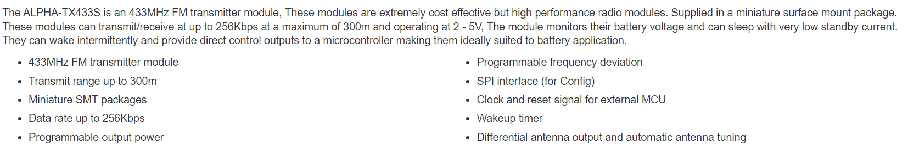

Slide 18
POWER SYSTEM MANAGEMENT

Slide 19
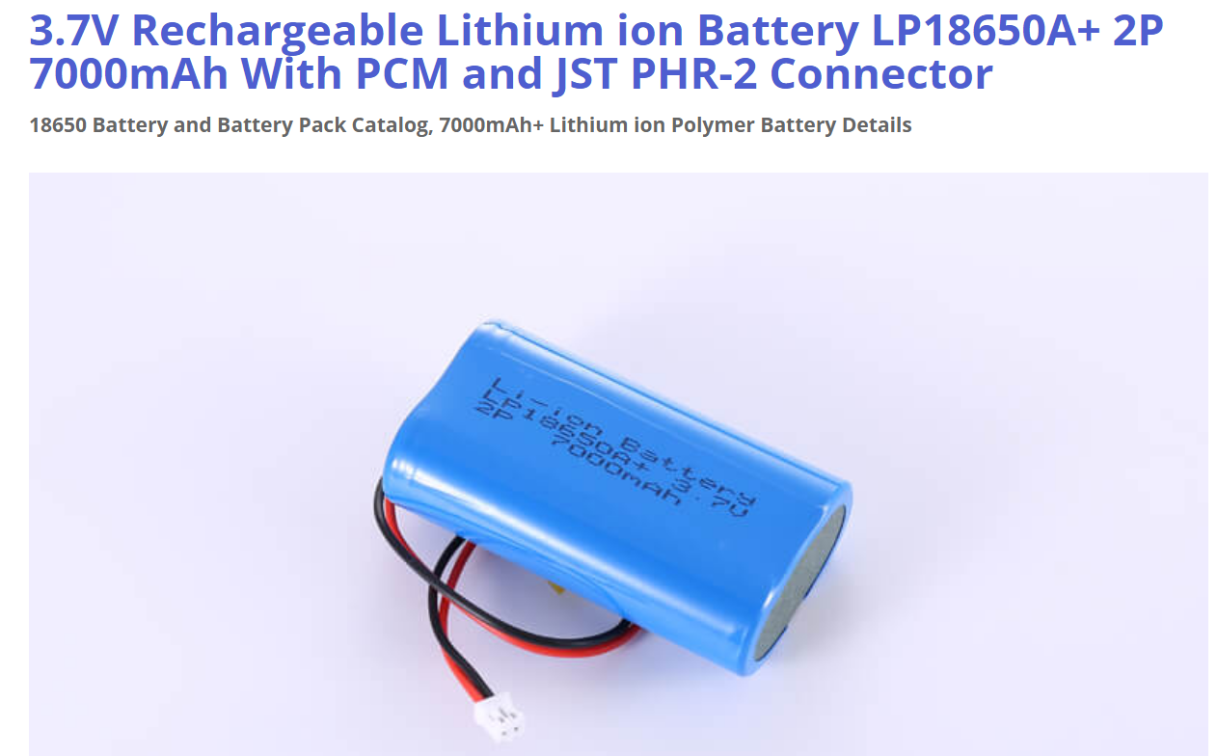
Lithium-Potassium Battery

